Slide 1
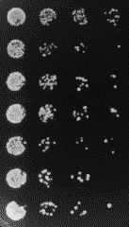
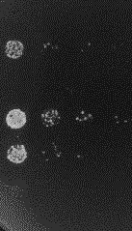
No Aur
+Aur
Stop codon
GGGGDFDLDMLGDFDLDMLG
DDDDDDDDDDWWWWWWWWWW
DWDWDWDWDWDWDWDWDWDW
WEDPWADPWPDGWPDLWADV
WNDYWTDSWADYWYDFWYDV
WFDSWDDFWCDCWCDCWSDF
Fig. 4 Panel E. Growth phenotype on the media without (No Aur) and with Aureobasidin (+Aur) for yeast strains containing indicated sequences as Gal4 AD. Three-fold serial dilutions are shown.

